Slide 1

Beauty and the Beast
Team 8

Slide 2
CONTENTS
01
BACKGROUND
02
OVERVIEW
03
DEVELOPMENT

Slide 3
01
BACKGROUND

Slide 4
01
BACK
About 5 billion dollars
30% increase
Reference: KITA

Slide 5
01
BACK
About 170,000 of subscribers
Reference: Newsroom

Slide 6
01
BACK
Never
Everyday
3~4 per week
85% of people have watched the beauty contents
Once a month
1~2 per week
2~3 per month
Reference: MezzoMedia

Slide 7

01
BACK
?

Slide 8
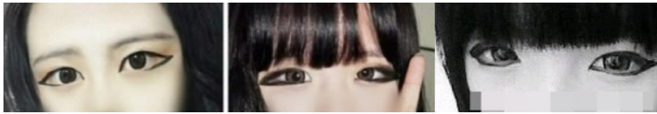
01
BACK
?!

Slide 9
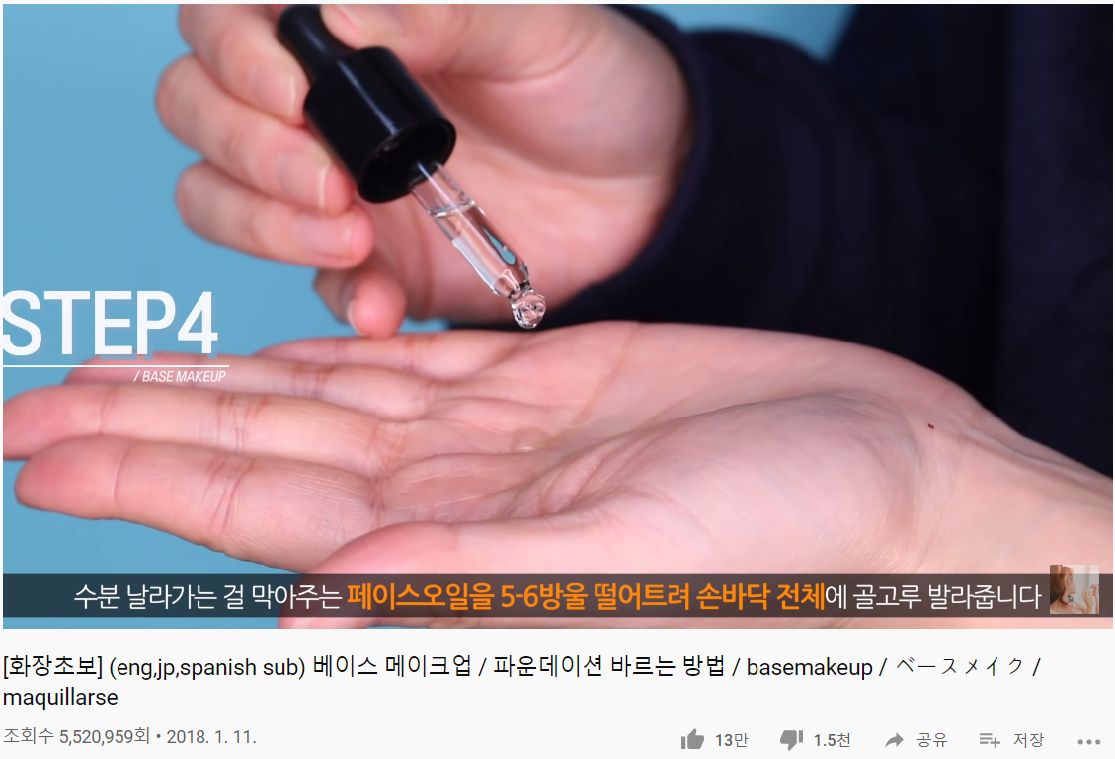
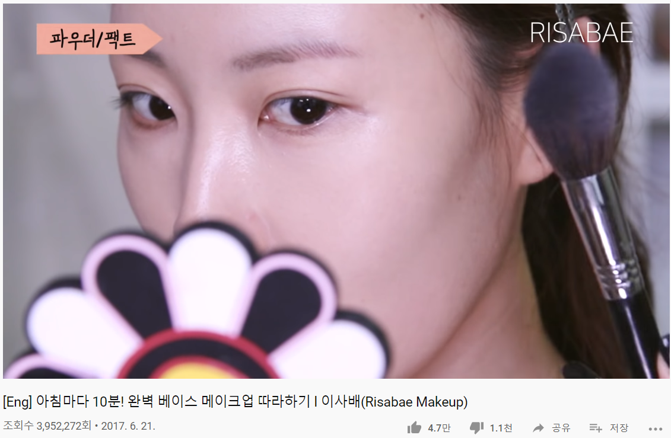
01
BACK
5,520,959 views
3,952,272 views

Slide 10
01
BACK

Slide 11
02
OVERVIEW

Slide 12
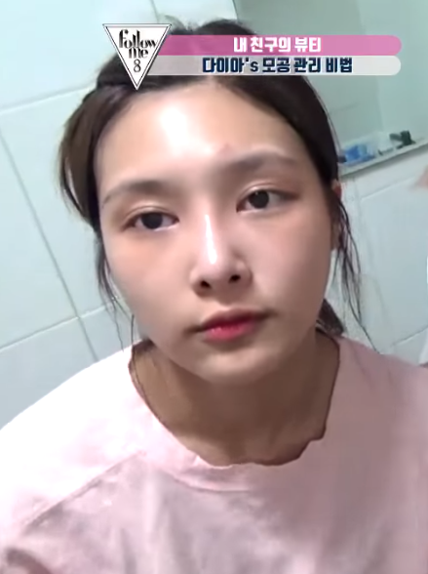
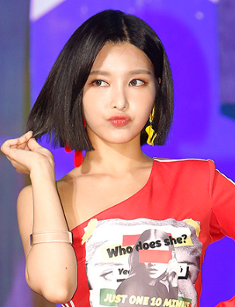

02
VIEW
Take a selfie
(with no makeup)
Find celebrities with a similar face
Apply the makeup of celebrity

Slide 13




02
VIEW
+
=
Find similar celebrities
Face filtering
Fusion

Slide 14
03
DEVELOPMENT

Slide 15







03
DEV
Front
Server
AWS EC2
Retrofit
Android
JAVA
CNN model Machine learning

Slide 16
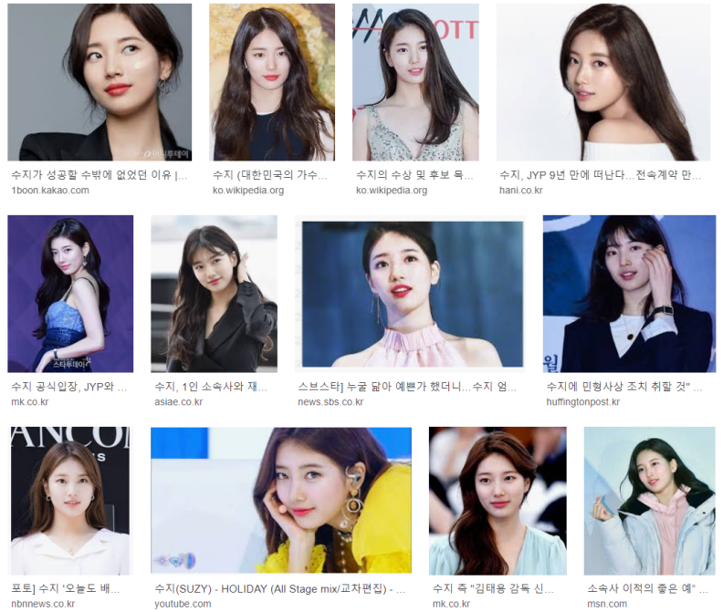
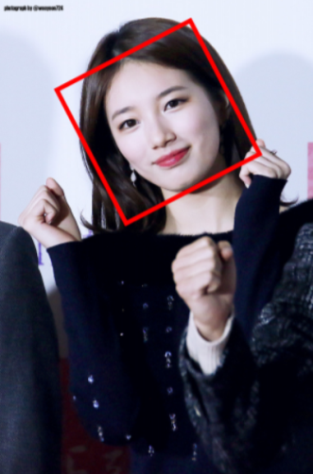
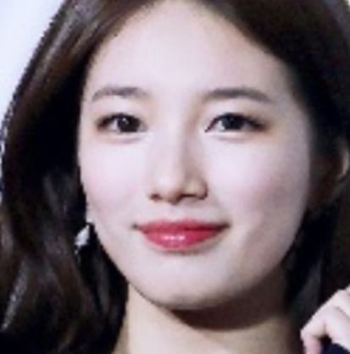
03
DEV
icrawler
imutils
Google search
Crawling
Extraction

Slide 17
Thank you

Slide 18
Reference
http://file.mk.co.kr/imss/write/20190312131442__00.pdf
http://newsroom.bigfoot9.com/2019/05/22
http://news.khan.co.kr/kh_news/khan_art_view.html?artid=201510302220455&code=940100
https://www.slideshare.net/MezzoMedia/2019-135035296
https://www.youtube.com/watch?v=U2h2he09AEk
https://www.youtube.com/watch?v=yIOZwL36AqE
https://kangbk0120.github.io/articles/2018-02/cnn-celeb

